Slide 1
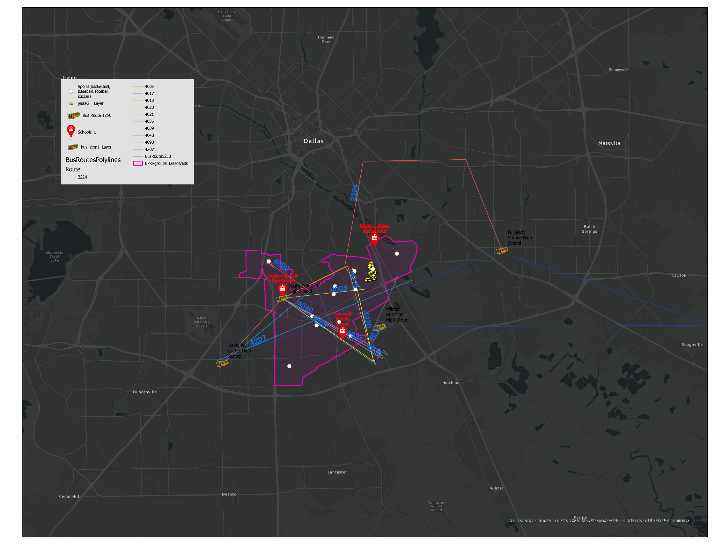
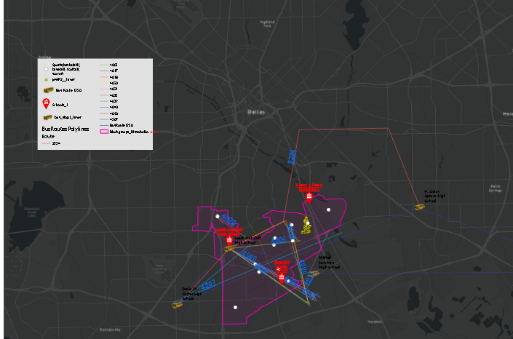
Dallas
GIS
Fruitdale

Slide 2
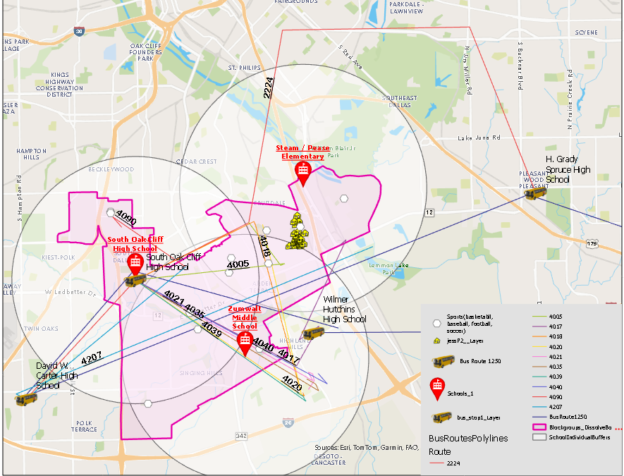
SOC feeder zone for site-visit houses. School buffer - 3 miles from each school. Bus routes to high school. Route 1250 is the DISD recommended bus for everyone residing in the area I visited.

Slide 3
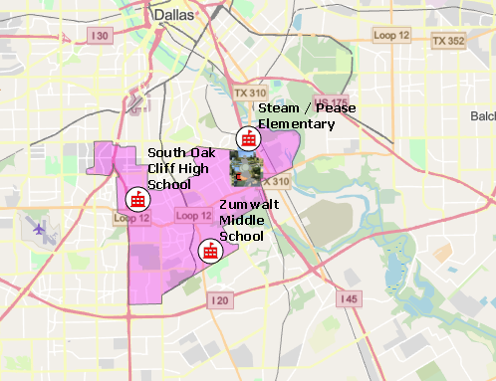
Defining SOC boundaries from DISD and site visit

Slide 4
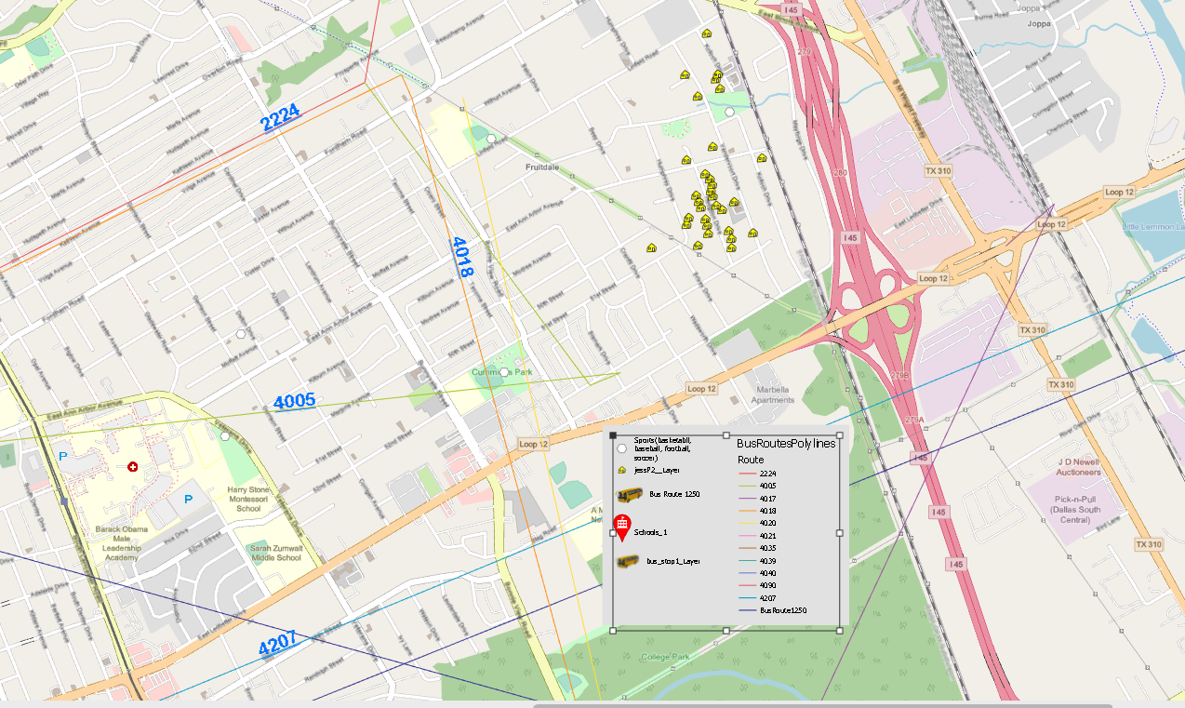
Bus Lines

Slide 5
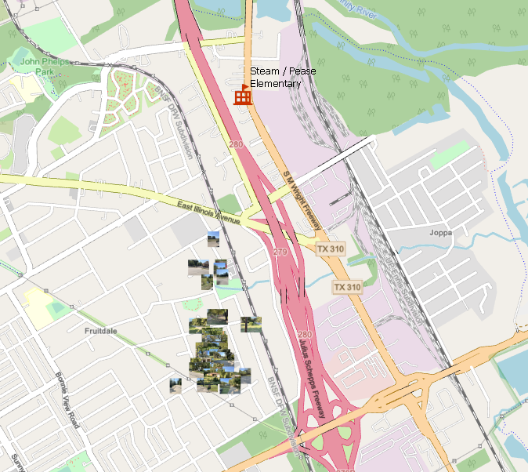
Houses in relation to Pease Elementary

Slide 6
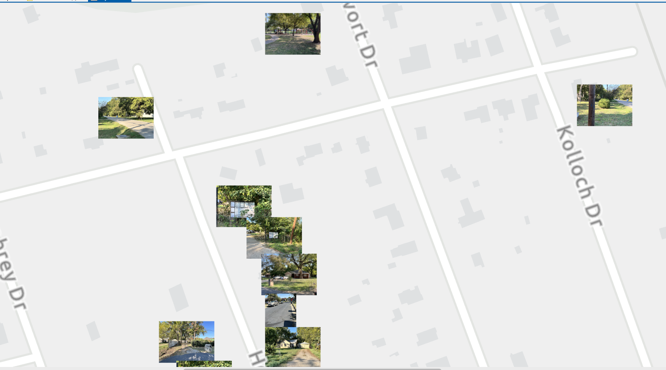
Houses visited
# 1 of 3

Slide 7
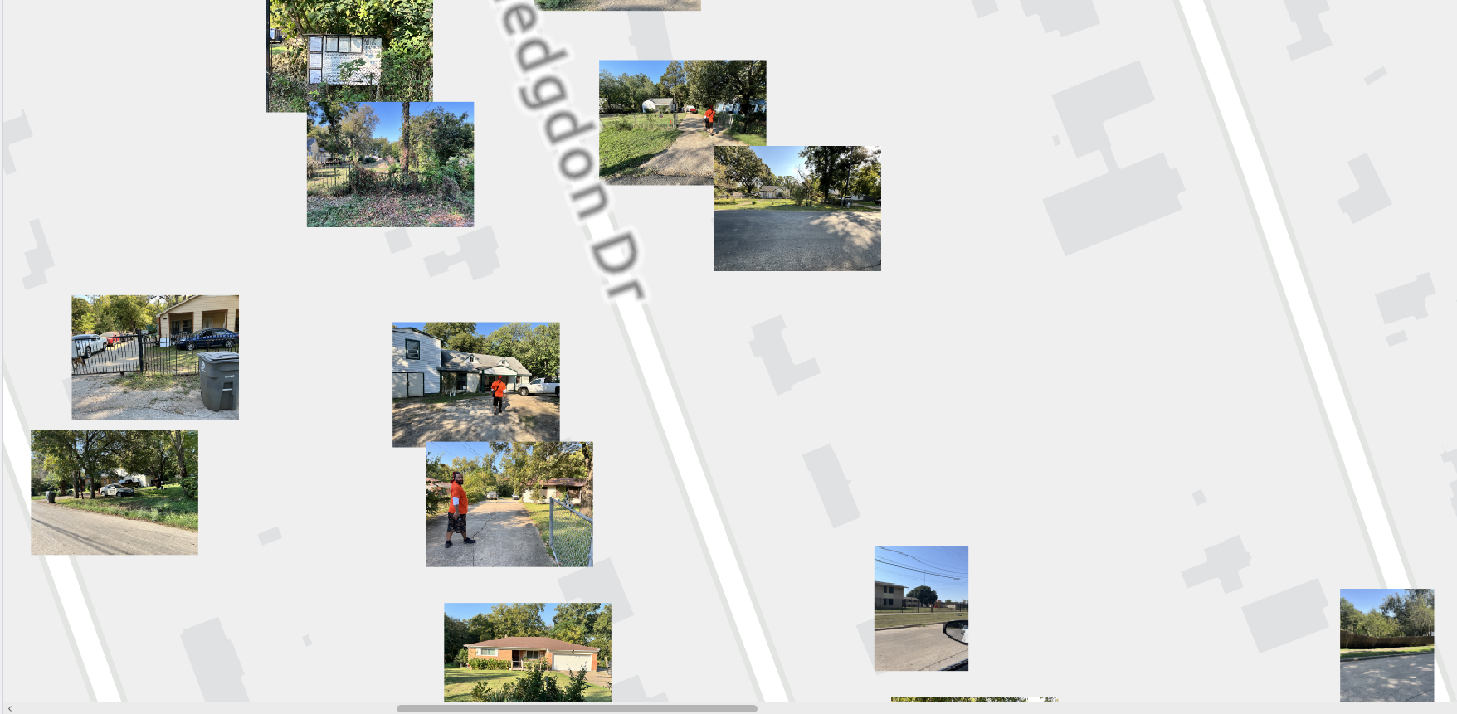
Houses visited
# 2 of 3

Slide 8
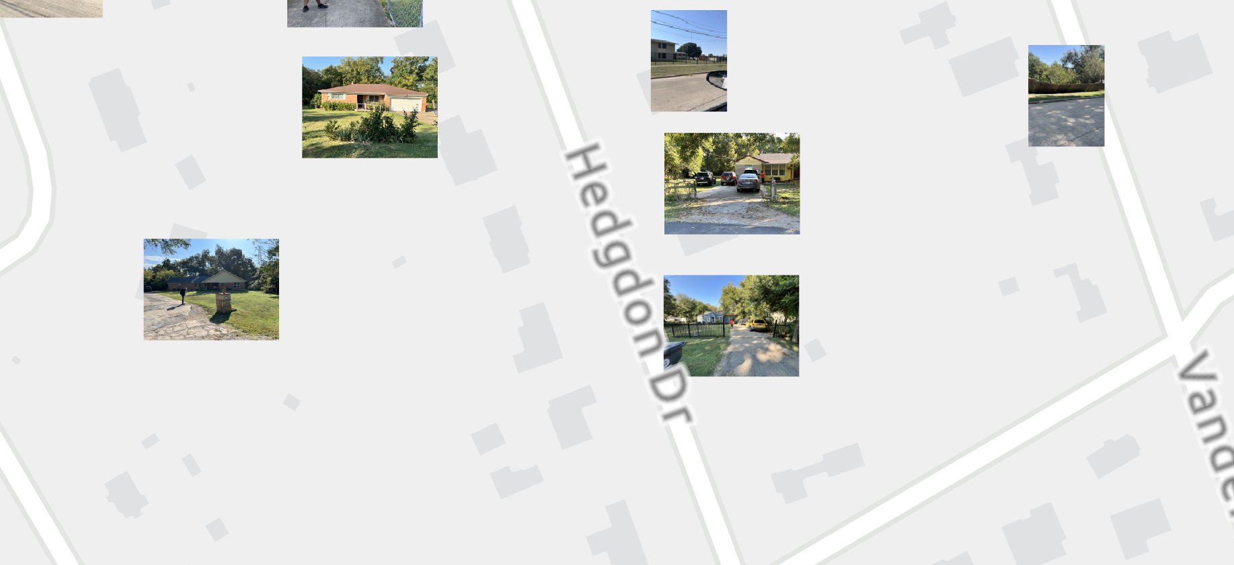
Houses visited
# 3 of 3

Slide 9
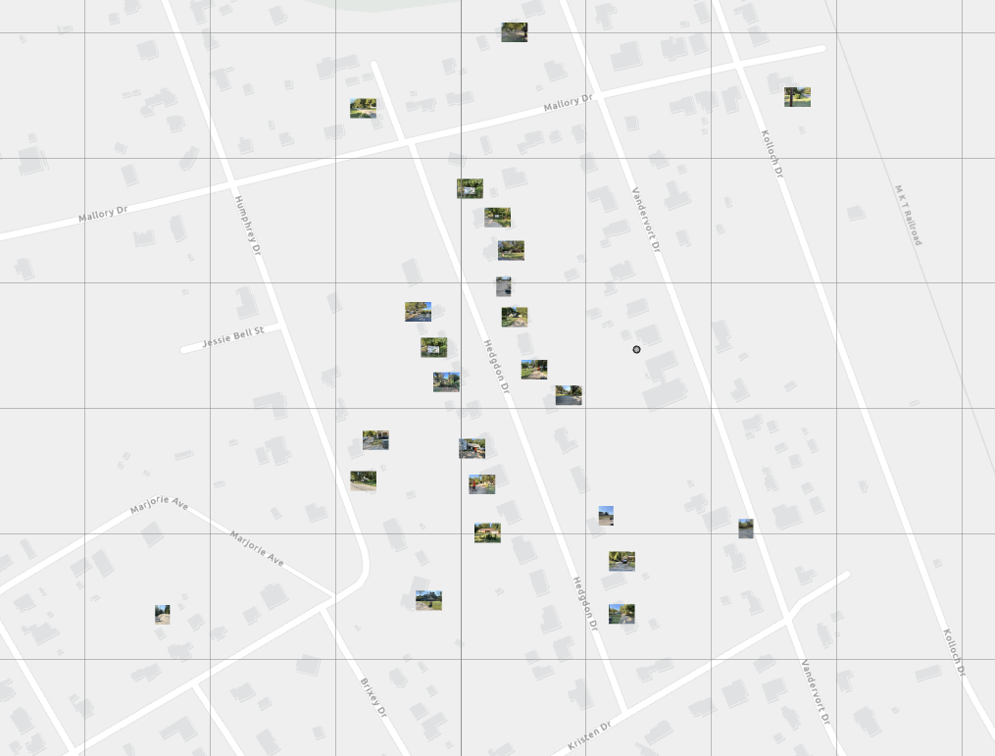
Houses visited
Overview with all.

Slide 10
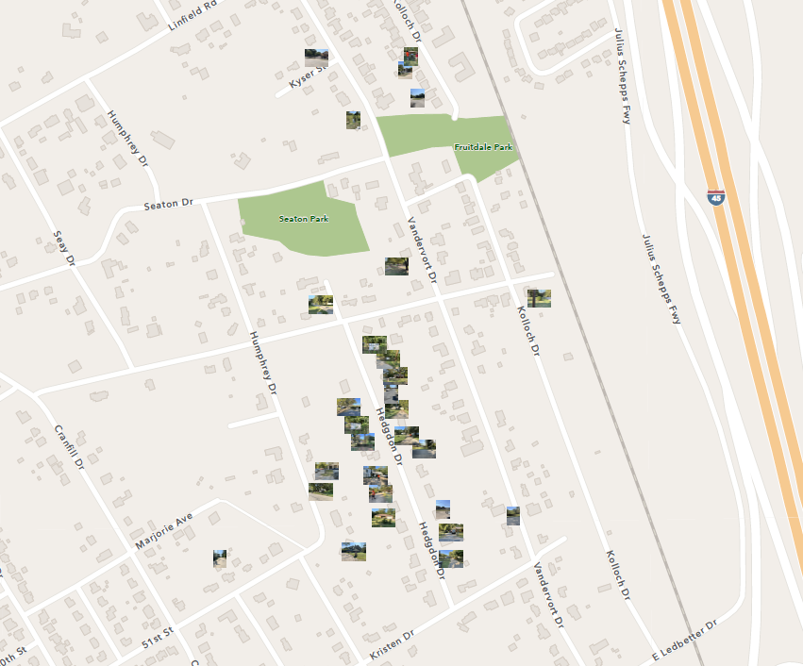
Houses visited
Overview with all. (#2)

Slide 11
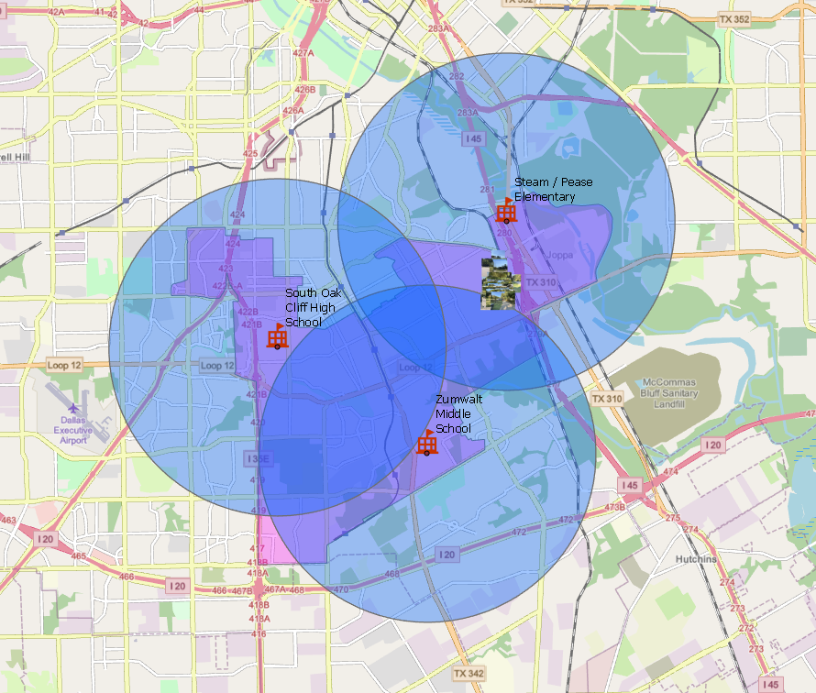
3 Mile Buffer

Slide 12
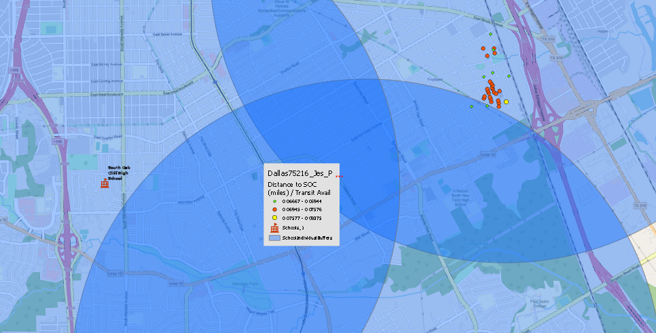
Distance Classification & Interpretation
1. Distance Classes (Natural Breaks - Jenks):
Class 1 (≤ 0.06944 miles)
Closest to SOC; smallest symbols.
Class 2 (0.06945 – 0.07576 miles)
Intermediate distances; medium symbols.
Class 3 (> 0.07576 miles)
Farthest from SOC; largest symbols.
Symbol sizes emphasize proximity trends, aiding spatial interpretation.
2. Key Insights
Proximity:
Smaller symbols = better access, larger = limited.
Transit Normalization:
Accounts for transit availability, not just physical distance.
Spatial Trends:
Dense clusters (nearby) reflect likely high interaction with SOC.
Sparse far points indicate potential access challenges.
3. Applications
Planning:
Guide improvement of transit routes or stops.
Equity:
Identify underserved regions lacking accessibility.
Decision Making:
Prioritize investments in transit infrastructure or services.
Distance to SOC normalized by transit available.

Slide 13
FROM LAST SLIDE:
Graduated Symbols: Visual emphasis on distance trends.
Smaller symbols = Closer proximity.
Larger symbols = Greater distance.
Impact of Transit Availability:
Normalization by "Transit Avail":
Accounts for transportation accessibility.
Highlights areas where proximity doesn't equal accessibility due to transit gaps.
Spatial Trends:
Clusters in Class 1:
Indicate regions with better access.
Potentially higher student attendance or transit stops.
Sparse Points in Class 3:
Signal areas with limited access.
May face transportation challenges.
Applications and Insights
Urban & School District Planning:
Transit Improvements:
Identify where new routes or stops are needed.
Accessibility Equity:
Assess if certain communities lack access to SOC.
Resource Allocation:
Focus Areas:
Direct efforts toward improving transport in underserved regions.
Consider new facilities or services where needed.
Further Analysis Possibilities
Demographic Overlay:
Correlation Discovery:
Analyze relationships between distance to SOC and socioeconomic factors.
Priority Investment:
Address needs in underserved communities based on identified trends.
By classifying distances into meaningful groups, this analysis aids in understanding and improving geographical accessibility to South Oak Cliff High School, highlighting the interplay between distance, transportation infrastructure, and community needs.

Slide 14
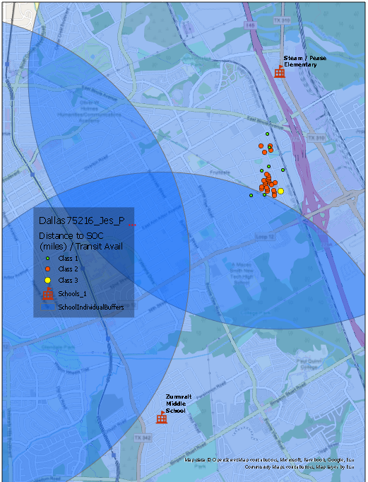
Catalog View

Slide 15
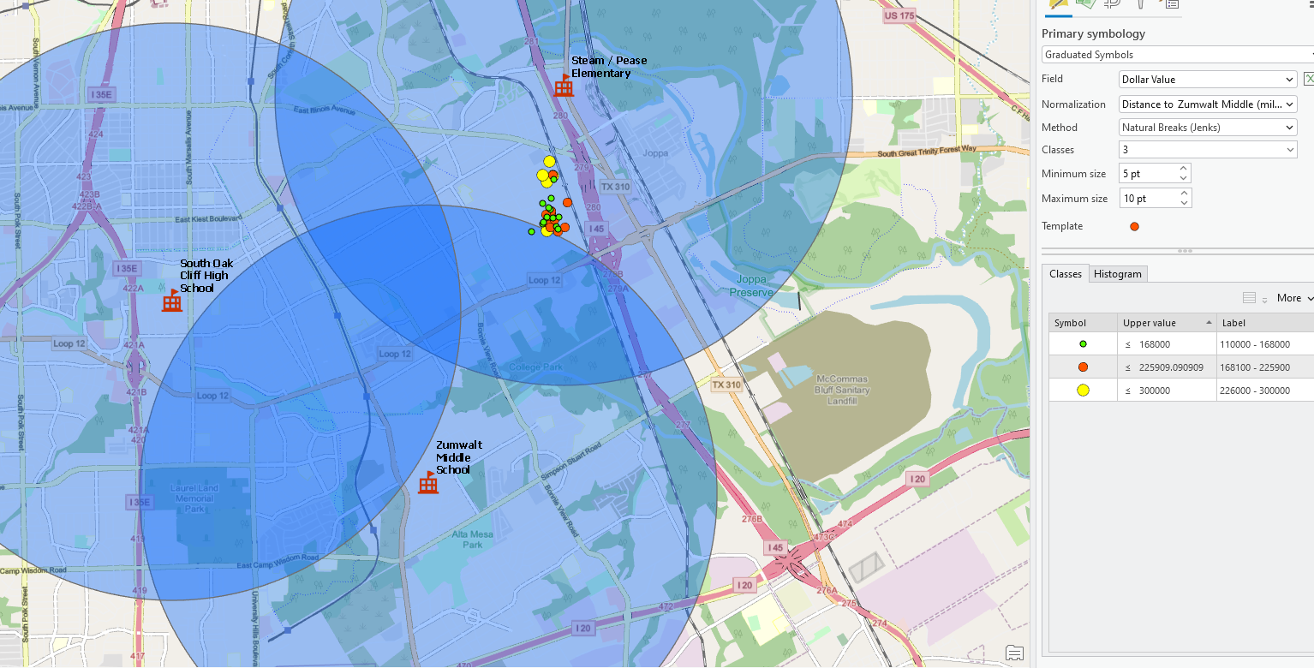
Dollar value normalized by distance to Zumwalt middle.

Slide 16
Analysis from previous slide:
Dollar Value Distribution and Proximity to Zumwalt Middle School
This map uses graduated symbols to represent "Dollar Value" in relation to Zumwalt Middle School, classified into three categories using the Natural Breaks (Jenks) method.
Class Breakdown
Green Circles (≤ $168,000)
Symbol Size: Smallest
Dollar Value Range: $110,000–$168,000
Interpretation: Highlights areas of lower economic value, potentially reflecting less-developed or economically challenged neighborhoods.
Orange Circles ($168,001–$225,900)
Symbol Size: Medium
Dollar Value Range: $168,001–$225,900
Interpretation: Represents mid-range property values, suggesting moderate economic activity and mixed-income communities.
Red Circles (≤ $300,000)
Symbol Size: Largest
Dollar Value Range: $226,000–$300,000
Interpretation: Indicates higher economic value, likely in wealthier areas. Proximity to Zumwalt Middle may enhance desirability.
Insights & Analysis
Proximity Effects:
Red and orange symbols cluster closer to Zumwalt Middle, hinting at potential economic benefits tied to proximity.
Green symbols dominate farther areas, potentially reflecting lower values.
Socioeconomic Distribution:
Red/orange clusters may suggest neighborhoods with better infrastructure and desirability.
Green areas may represent underserved or economically disadvantaged regions.
Actionable Insights:
Urban Planning: Focus investments in green circle areas to promote economic growth.
Educational Impact: Study how school proximity correlates with property values.
Transportation: Address access issues to connect underserved areas with key facilities.
Limitations
Other factors, such as amenities, zoning, or transit access, also influence property values and must be considered alongside this analysis.
Conclusion:
This map reveals the spatial relationship between economic value and proximity to Zumwalt Middle School, offering insights for urban planning, policy development, and socioeconomic analysis.

Slide 17
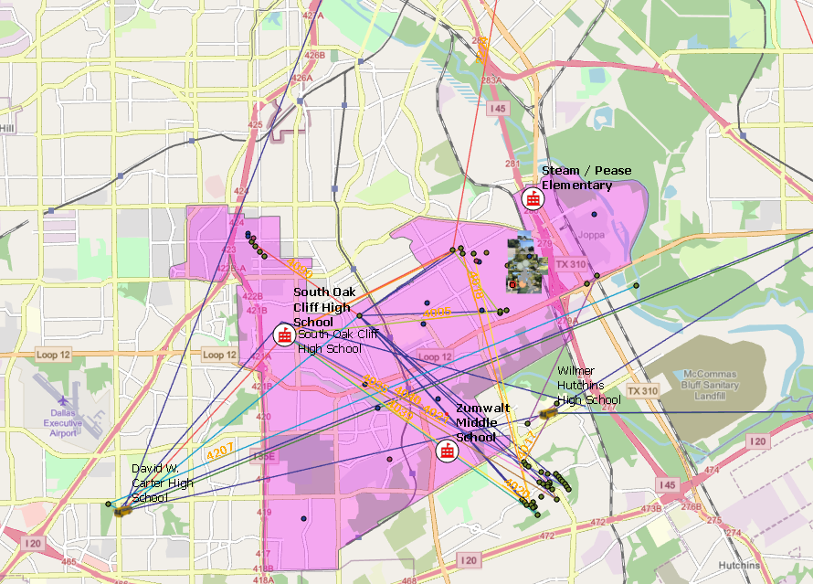
Area of study in pink, with bus routes on open streets map.

Slide 18
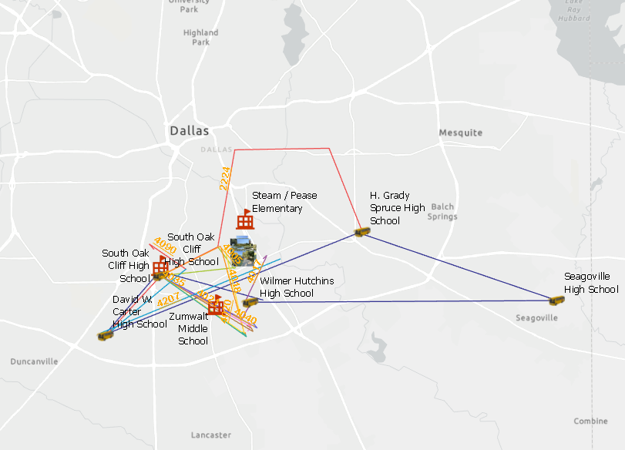
Just bus routes and schools.

Slide 19
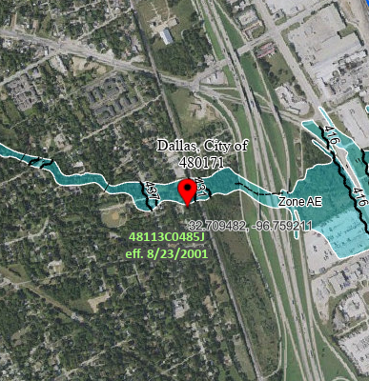
Area from Fema

Slide 20
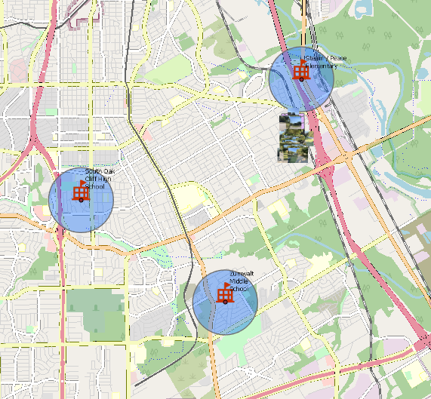
Buffered at 1 mile

Slide 21
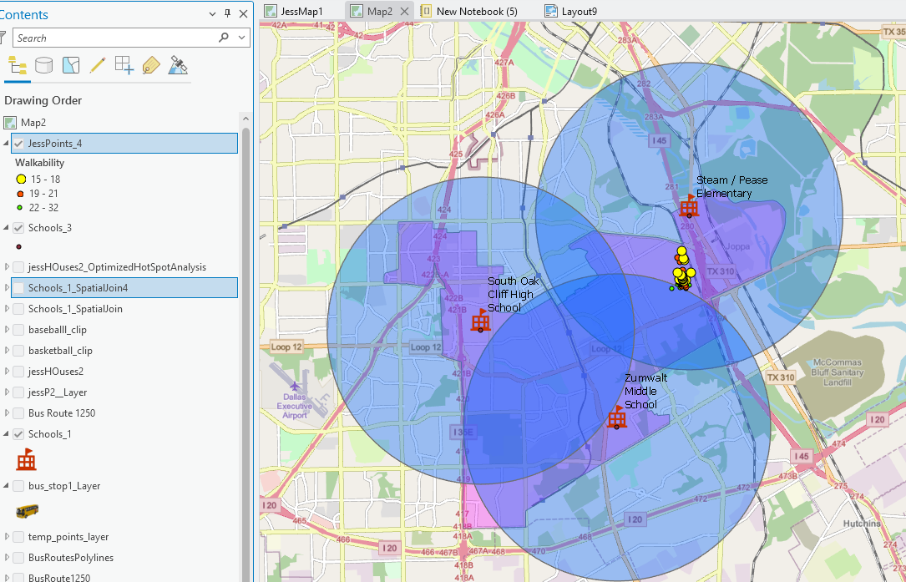
Walkability

Slide 22
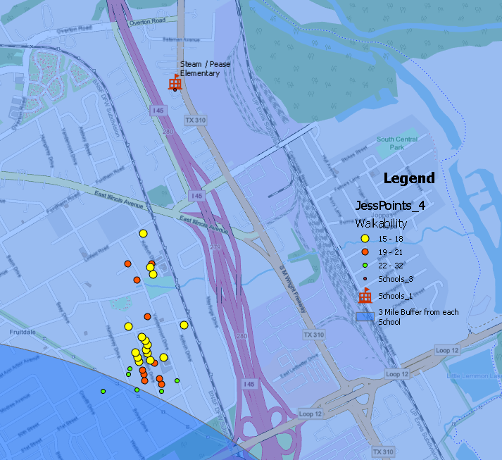
Walkability: Catalog View

Slide 23
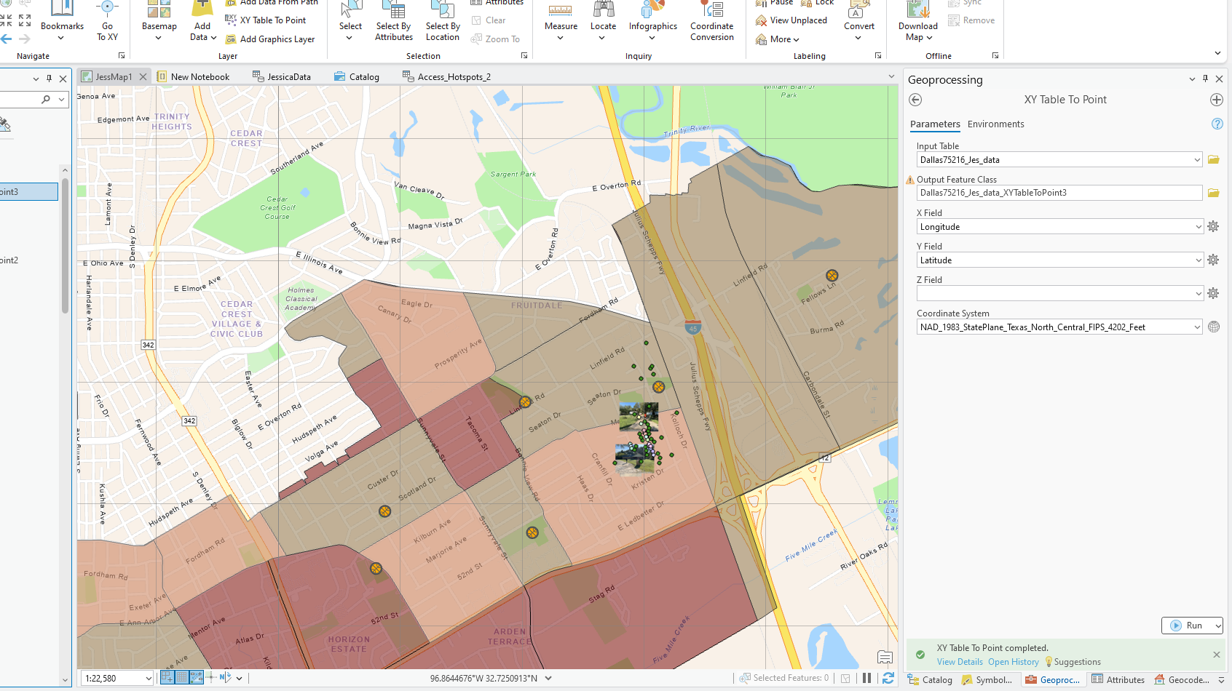
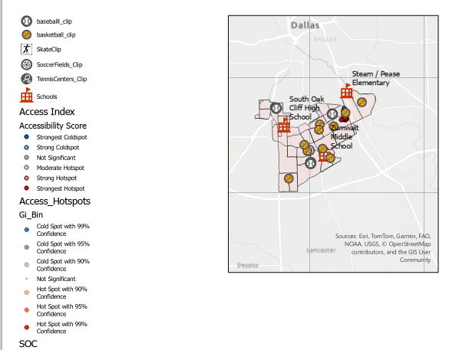
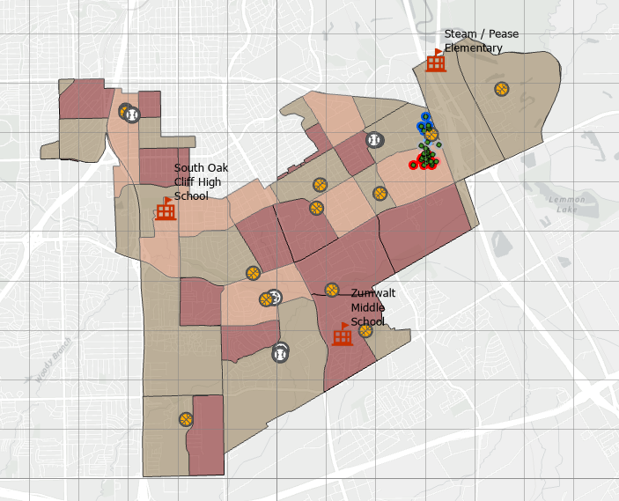
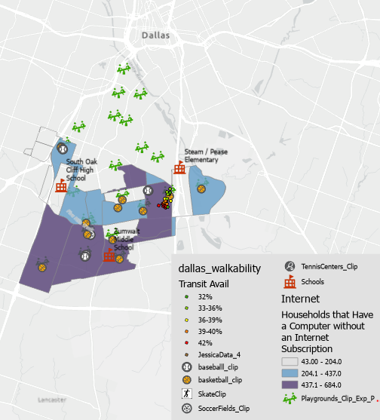
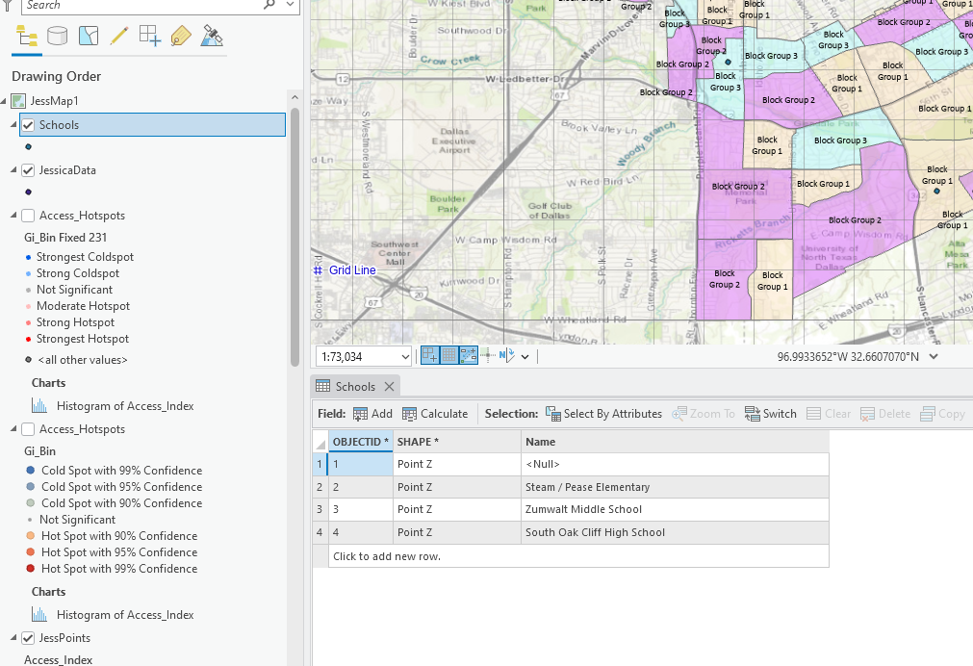
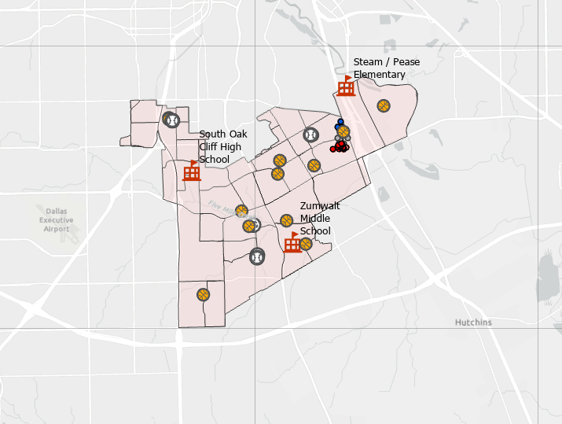
Early Maps
Early Map Progression

Slide 24
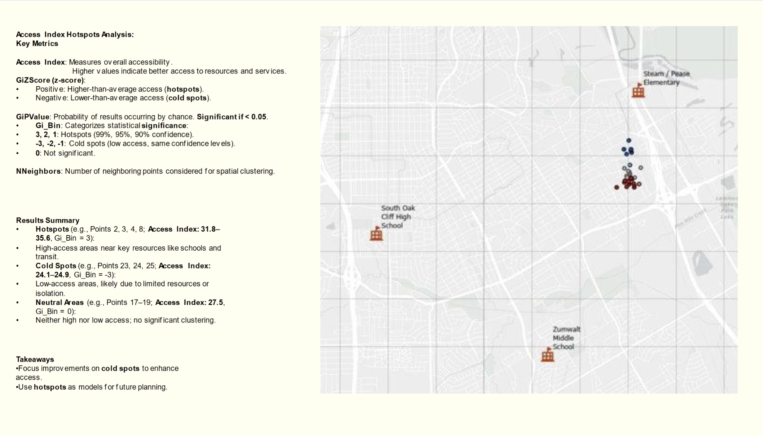

Slide 25
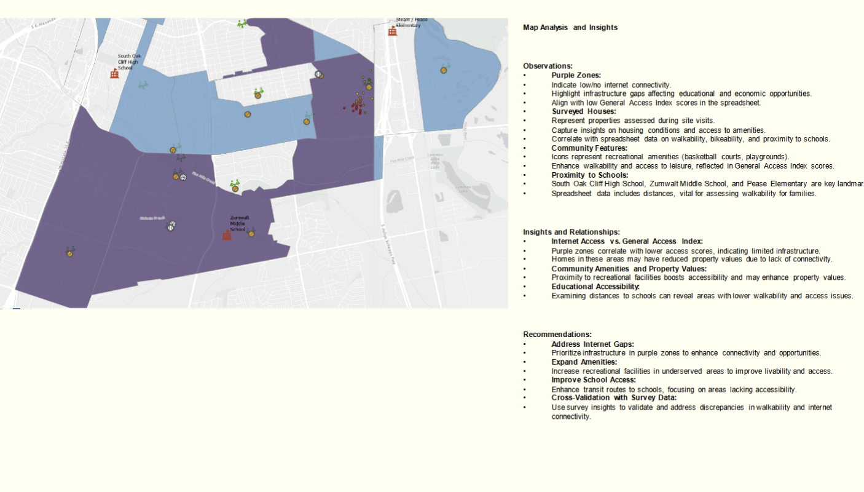

Slide 26
